Slide 1

CPRG 307 Slides are part of the Instructor Resources for the course required textbook and are provided with permission from the publisher:
Oracle 11g: PL/SQL Programming
Joan Casteel
978-1-133-94736-3
Course Technology (Cengage Learning)
Oracle11g:
PL/SQL Programming
Chapter 5
Procedures

Slide 2
Named Program Units
PL/SQL blocks executed thus far have been anonymous blocks
Now we will assign a name to the block and save it in the database as a stored program unit
This makes program units reusable
Oracle11g: PL/SQL Programming

Slide 3
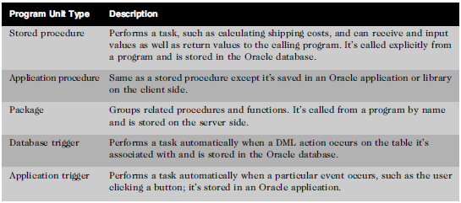
Types of Program Units
Oracle11g: PL/SQL Programming

Slide 4
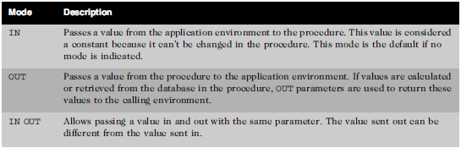
Parameters – Make Program Units Reusable
Mechanisms used to send values in and out of program units
Oracle11g: PL/SQL Programming

Slide 5
Parameters – Make Program Units Reusable
As a matter of course, only IN should be used.
The use of the OUT parameter is considered bad programming form
  Use a function if a value needs to be returned from a stored program
There are exceptions to this, but these are rare.
CPRG 307

Slide 6
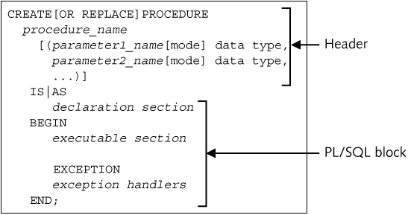
Create Procedure Statement Syntax
Oracle11g: PL/SQL Programming

Slide 7
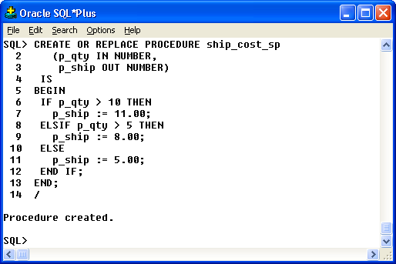
Create Procedure Execution
Procedure to determine shipping cost
Forward slash on last
line to execute
Oracle10g Developer: PL/SQL Programming

Slide 8
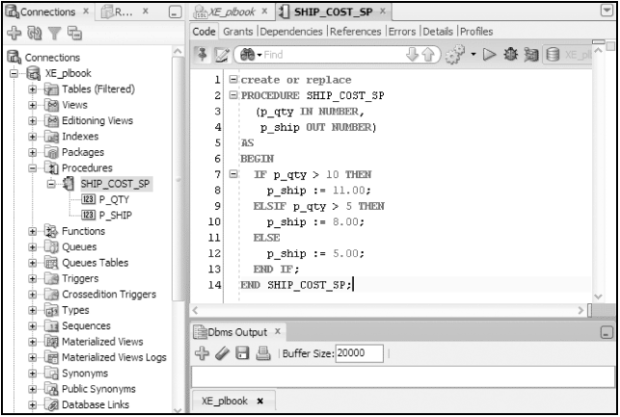
Create Procedure Execution
Procedure to determine shipping cost
Oracle11g: PL/SQL Programming

Slide 9
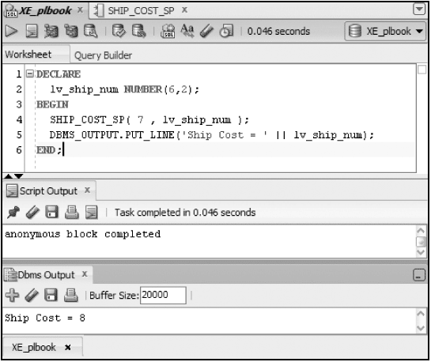
Execute/Test the Procedure
Declare a variable to hold value from OUT parameter
Call procedure addressing both parameters
Display value returned to verify
Note: Parameter arguments are passed positionally by default
Oracle11g: PL/SQL Programming

Slide 10
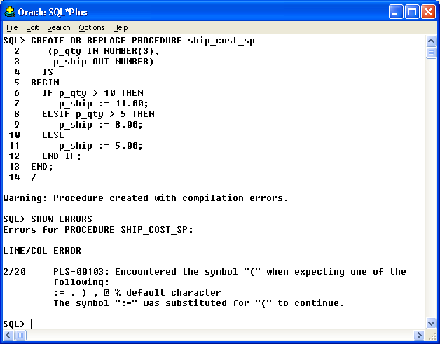
SHOW ERRORS Command
Error indicating parameter size
Compilation Error
Displays error message
Oracle10g Developer: PL/SQL Programming

Slide 11
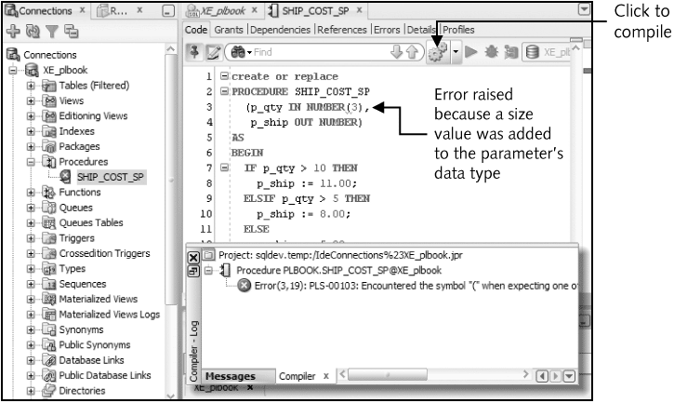
Compilation errors
Oracle11g: PL/SQL Programming

Slide 12
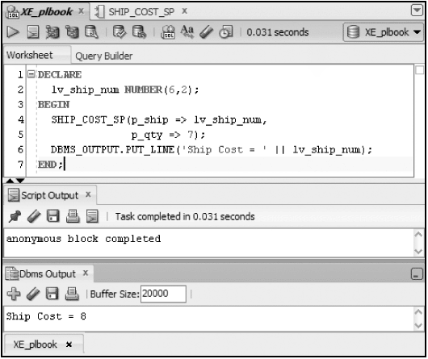
Named Association Method
Provide parameter values by position (default) or name
Oracle11g: PL/SQL Programming

Slide 13
IN OUT mode
Send value in and out via the same parameter
CREATE OR REPLACE PROCEDURE phone_fmt_sp
(p_phone IN OUT VARCHAR2)
IS
BEGIN
p_phone := '(' || SUBSTR(p_phone,1,3) || ')' ||
SUBSTR(p_phone,4,3) || '-' ||
SUBSTR(p_phone,7,4);
END;
Oracle11g: PL/SQL Programming

Slide 14
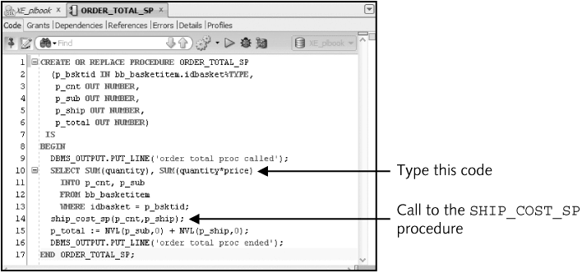
Calling a Procedure from another procedure
Oracle11g: PL/SQL Programming

Slide 15
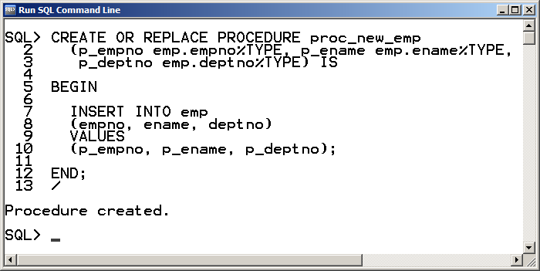
Procedure with %TYPE Parameters
CPRG 307

Slide 16
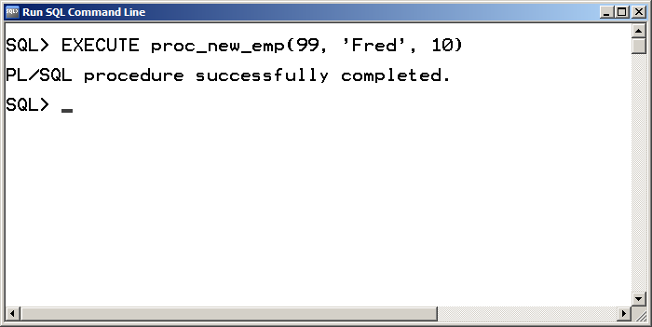
Procedure Call from Command Line
CPRG 307

Slide 17
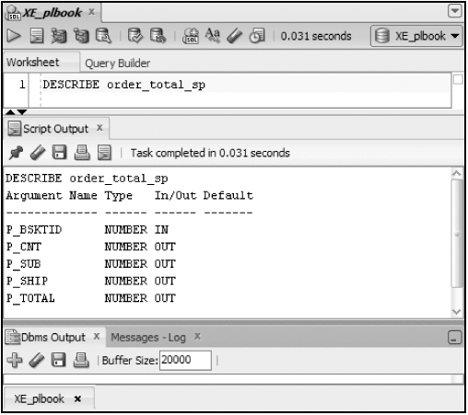
DESCRIBE Command
Lists the parameters of a program unit
Oracle11g: PL/SQL Programming

Slide 18
Debugging in SQL*Plus
Use DBMS_OUTPUT.PUT_LINE statements to display messages from execution
Must set SERVEROUTPUT ON
Place display messages throughout the block to determine processing flow and variable values
CPRG 307

Slide 19
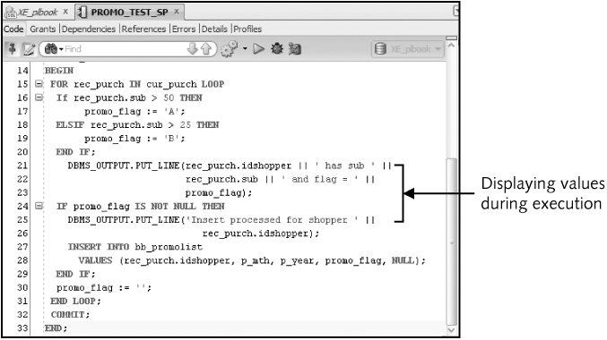
Debugging with DBMS_OUTPUT
Oracle11g: PL/SQL Programming

Slide 20
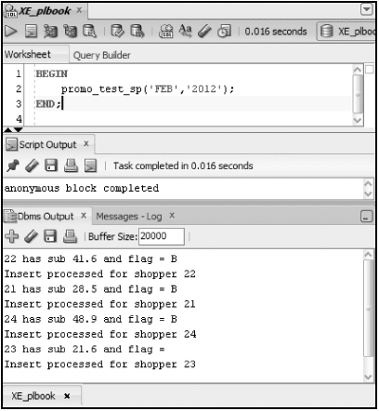
Debugging with DBMS_OUTPUT
Oracle11g: PL/SQL Programming

Slide 21
Subprograms
A program unit defined within another program unit
Must be declared in the DECLARE section of the containing program unit
Can only be referenced by the containing program unit
Oracle11g: PL/SQL Programming

Slide 22
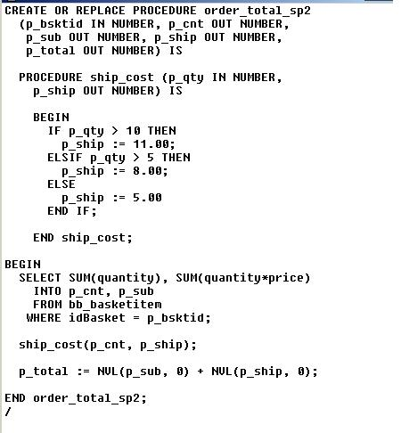
Subprograms
Oracle10g Developer: PL/SQL Programming

Slide 23
Variable Scope
When nesting blocks, are variables shared?
Inner blocks can use variables from outer blocks
Oracle11g: PL/SQL Programming

Slide 24
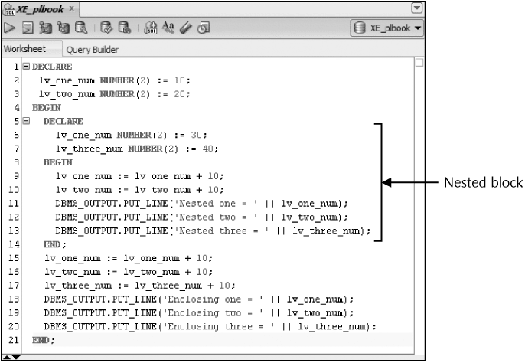
Variable Scope (continued)
Oracle11g: PL/SQL Programming

Slide 25
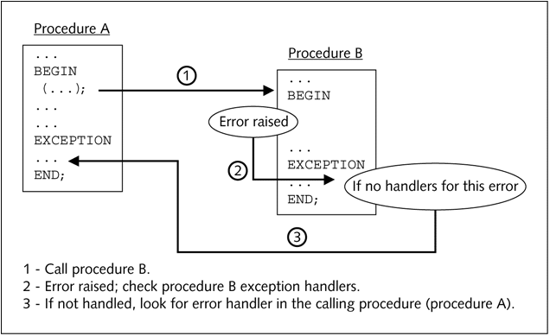
Exception-HandlingFlow
Oracle11g: PL/SQL Programming

Slide 26
Transaction Control Scope
The scope refers to the group of DML statements that are affected by a particular transaction control statement
By default, a session has a single DML queue and a transaction control statement would affect all DML in the queue regardless of which program unit initiated the statement
DML statements of a program unit can be treated separately or as an autonomous transaction
Oracle11g: PL/SQL Programming

Slide 27
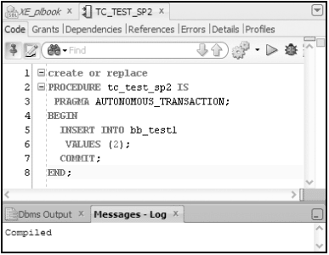
Autonomous Transaction
Oracle11g: PL/SQL Programming

Slide 28
Transaction Scope
In practice, transactional control statements are handled by the calling program
  An external GUI application
  Anonymous block
COMMITs and ROLLBACKs should not be put into procedures and functions.
  This makes these stored programs less reusable.
  Similar to what we did the with anonymous blocks, applications want a set of transactions to succeed or fail together as a unit. Placing transactional control statements in stored programs would cause issues with this.
CPRG 307

Slide 29
Data Dictionary
The DESCRIBE is how we can view the header information for a stored program.
To view the code stored in the database, look the USER_SOURCE view.
  Example:
    SELECT text
    FROM user_source
    WHERE name = 'SHIP_CALC_SF';
Oracle10g Developer: PL/SQL Programming

Slide 30
Remove a Procedure
DROP PROCEDURE procedure_name;
Oracle11g: PL/SQL Programming

Slide 31
Default Date Format
In Oracle 11g, the default date format has changed.
  Prior to 11g, the default format was: DD-MON-YY
  Starting in 11g, the “official” default is: YYYY-MM-DD; however, this is not consistent. The default date format is determined at install time by the operating system (OS).
You should never rely on a “default” format for this reason. Use TO_CHAR or TO_DATE to ensure a specific format in your code.
  This makes you code independent of a system set date format.
CPRG 307

